Slide 1
Smart Homes Comparison of ZigBee, Z-Wave, and Thread for Home Automation
Matt Krueger | Topics in Computer Science II: Real-Time Cyber-Physical Systems | Fall 2025

Slide 2
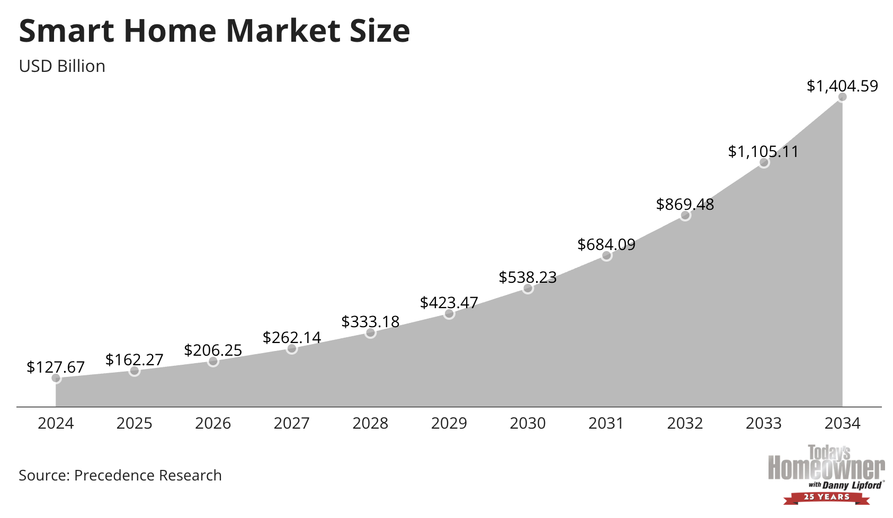
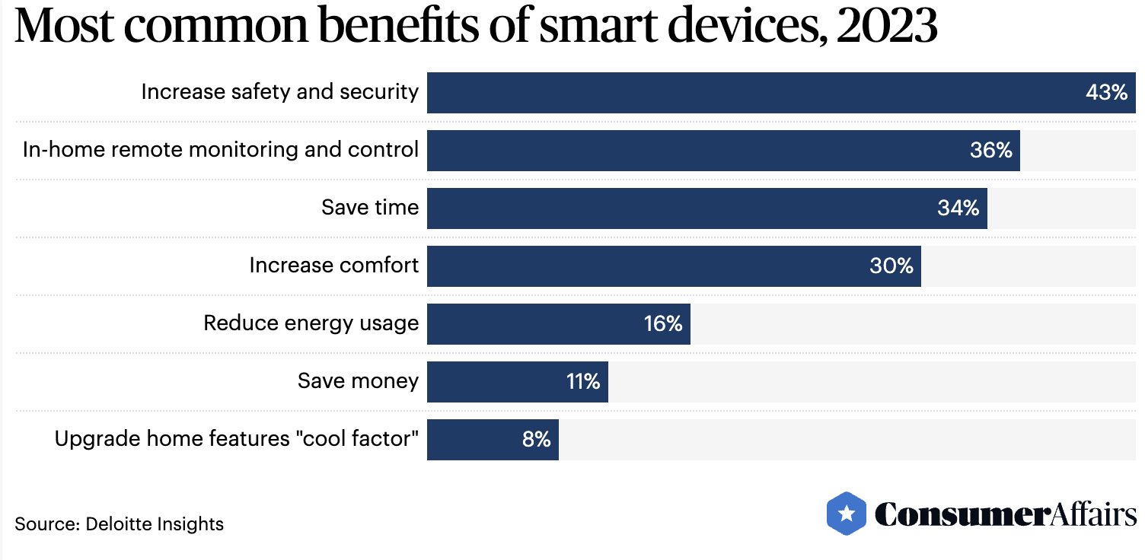
Background Growing industry with lots of benefits!

Slide 3
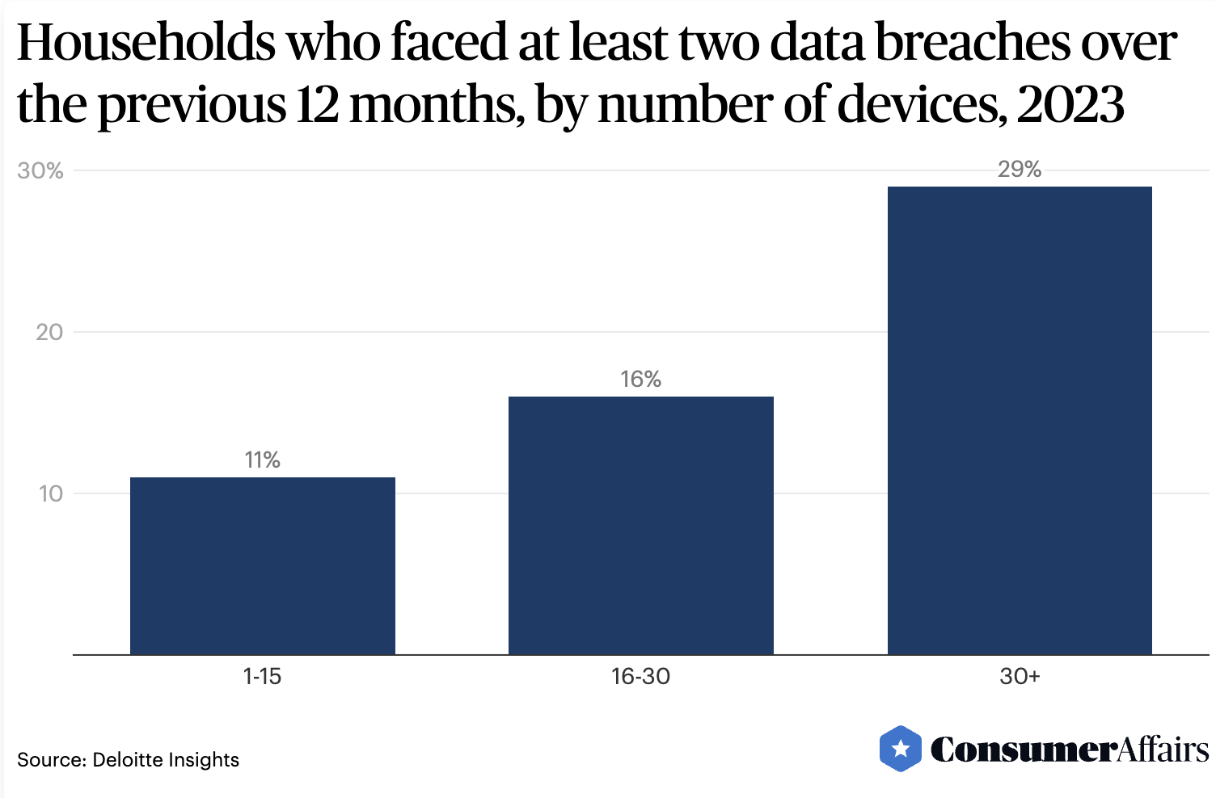
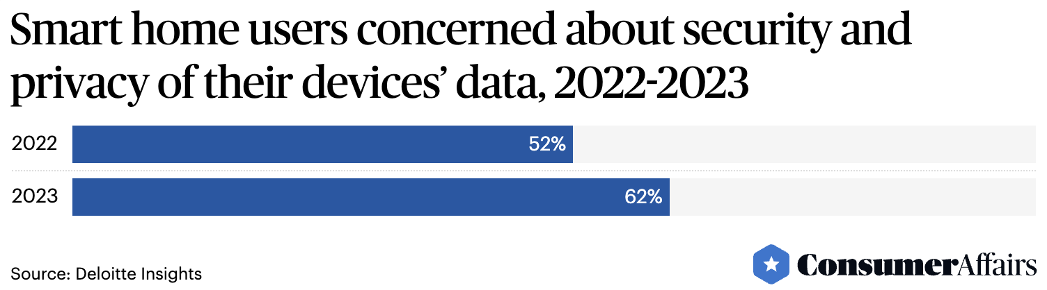
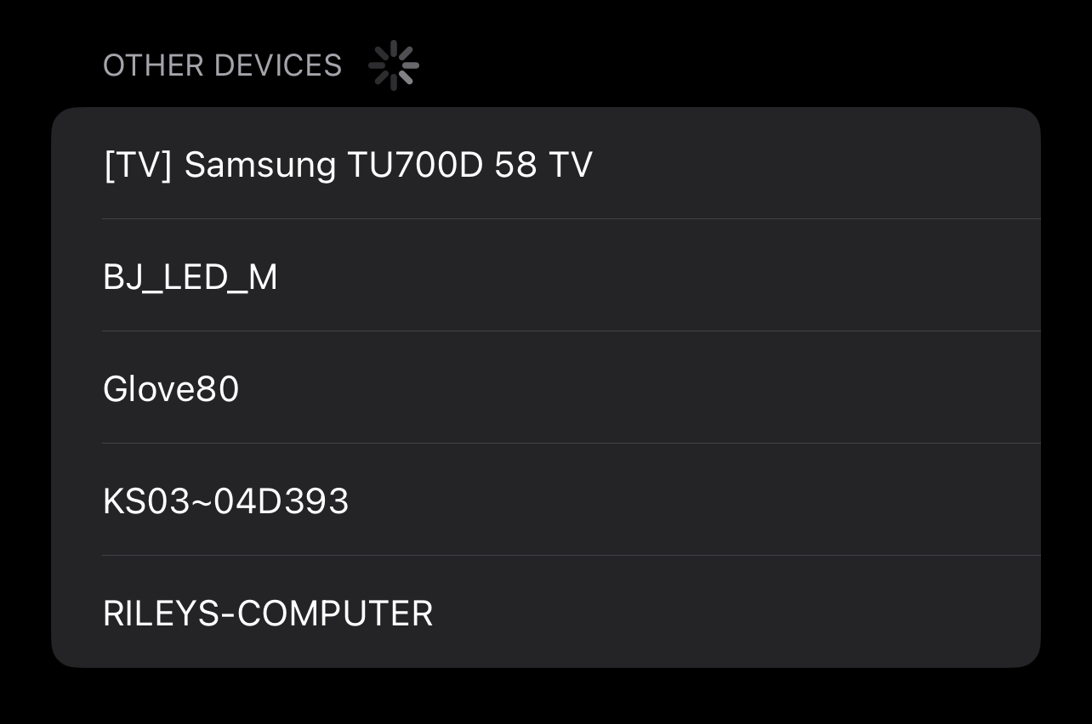
Background Digital == lots of attack vectors!

Slide 4
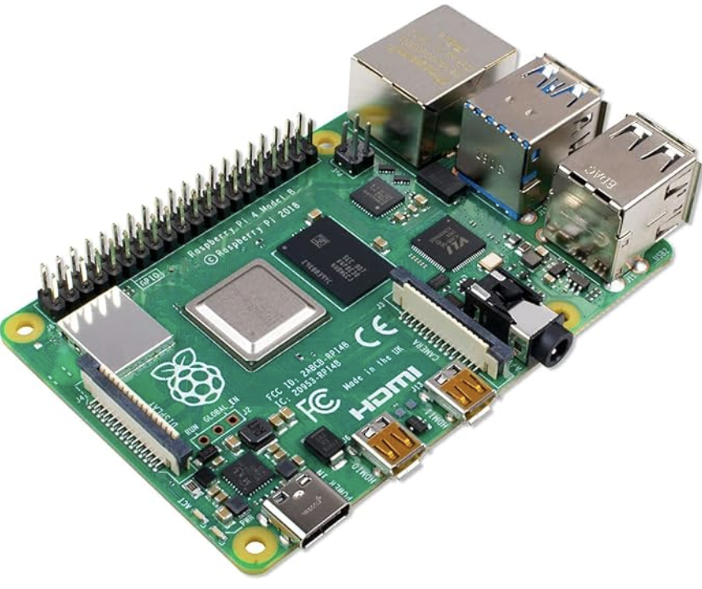
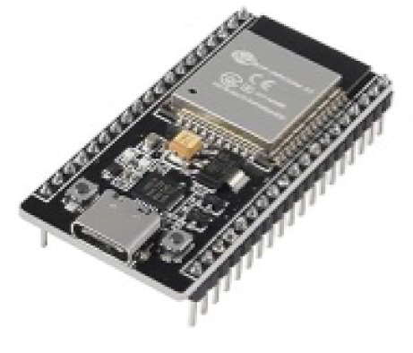
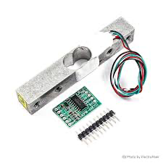

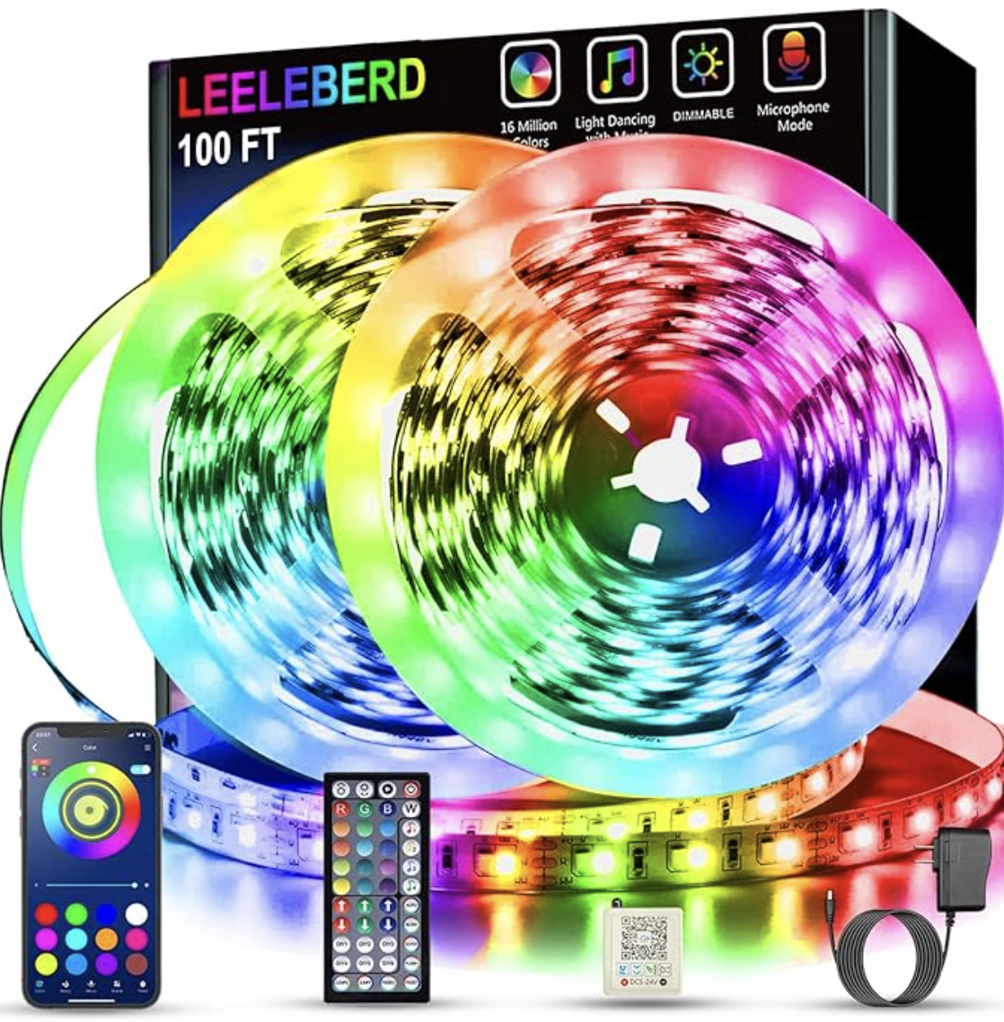
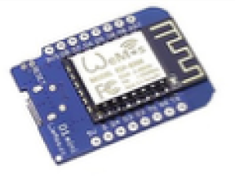

Motivation Personal Interest

Slide 5



Project Comparison of ZigBee, Z-Wave, and Thread for Home Automation
VS
VS

Slide 6
Goals
Learn About Industry Leaders
Architecture
Applications
Features
Compare Protocols
Performance
Security
Interoperability

Slide 7
Plan
Gather Information
High-Level Comparison
Present Results

Slide 8

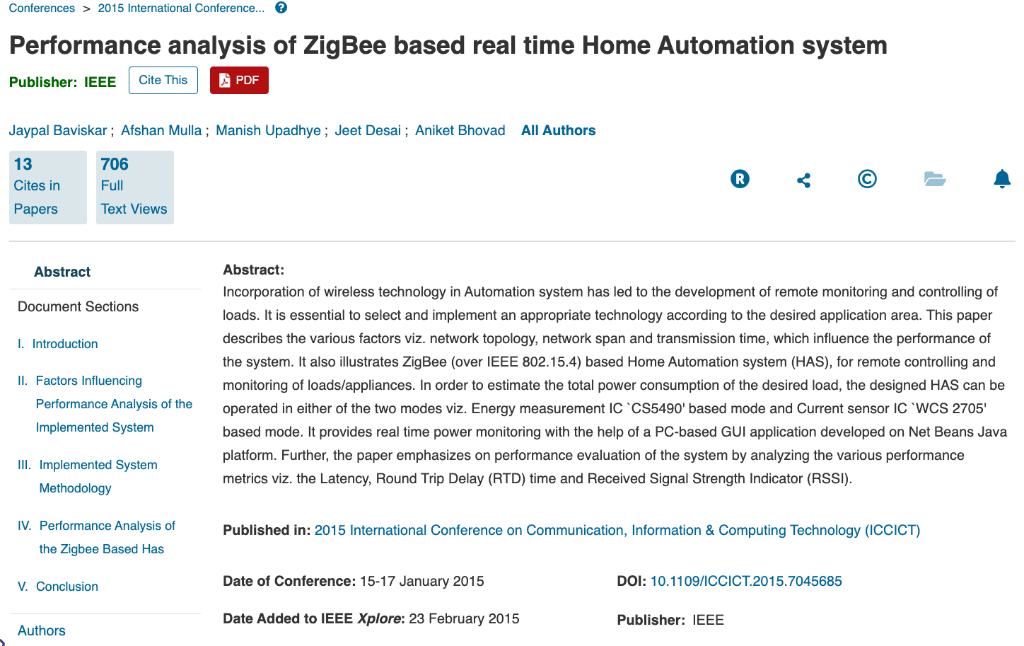
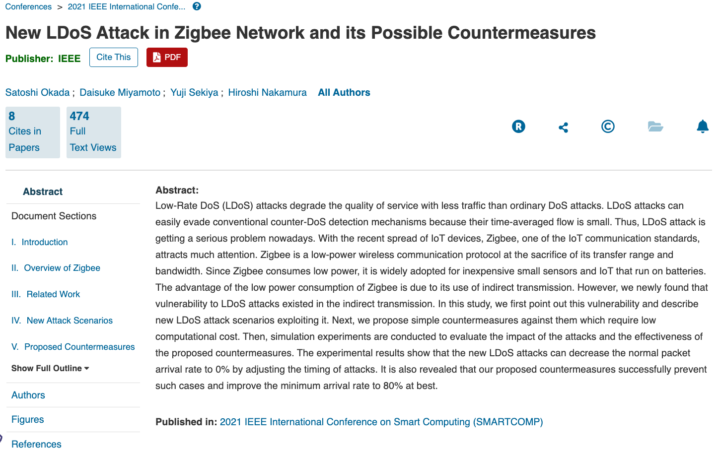
Plan
Gather Information

Slide 9
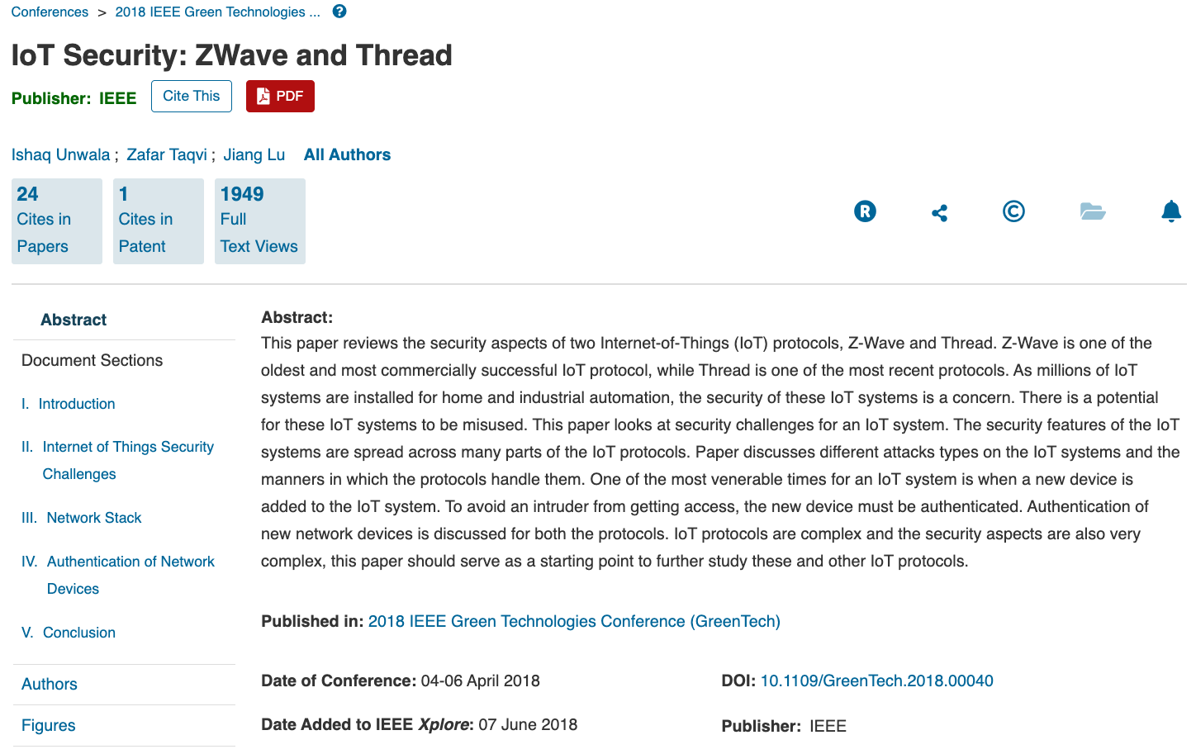
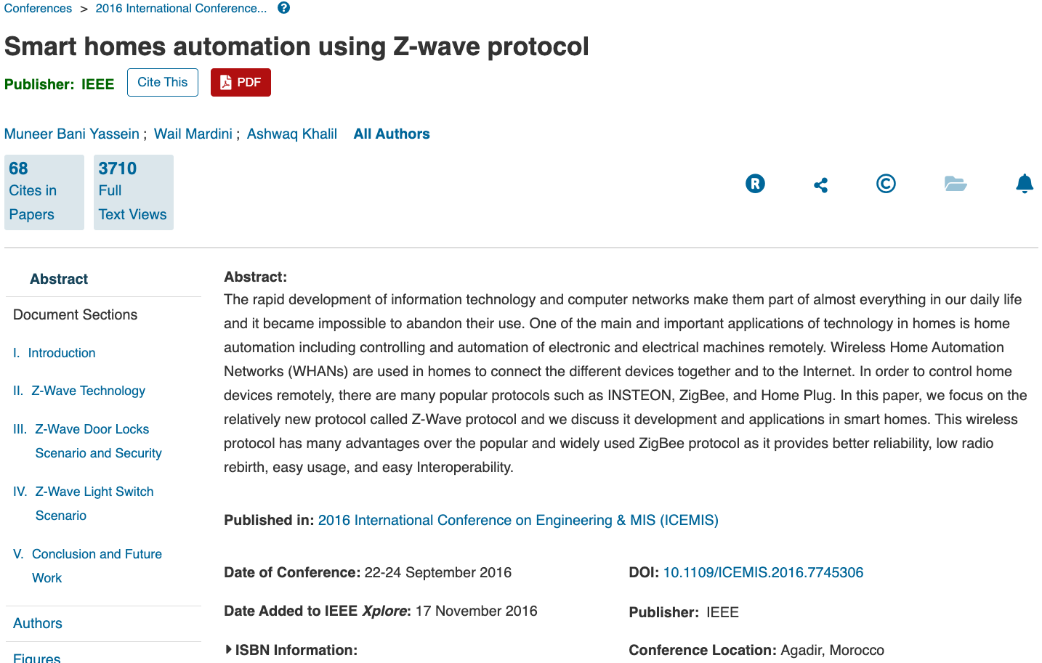
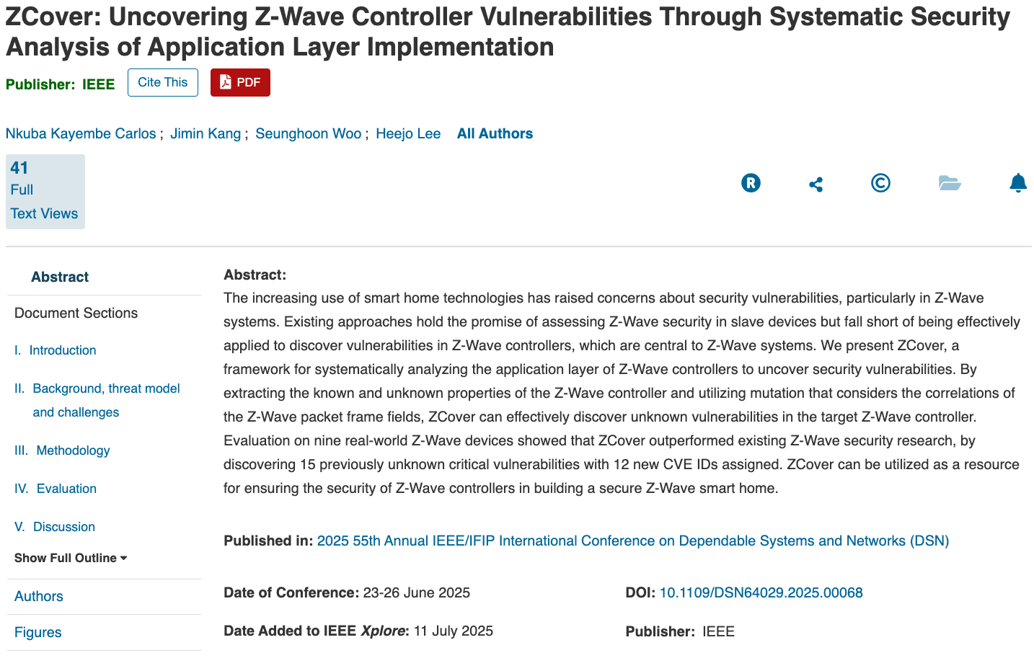
Plan
Gather Information

Slide 10
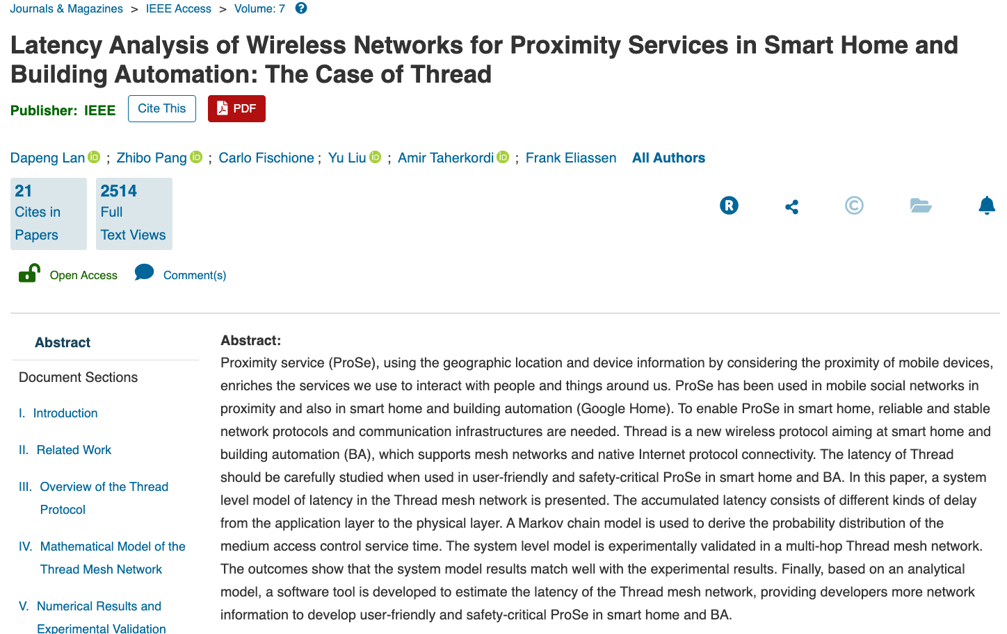
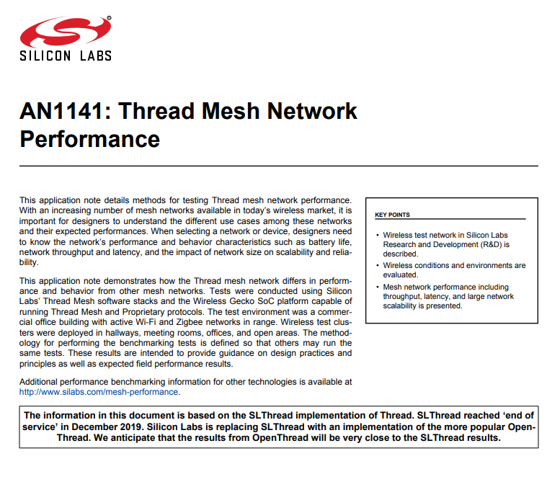
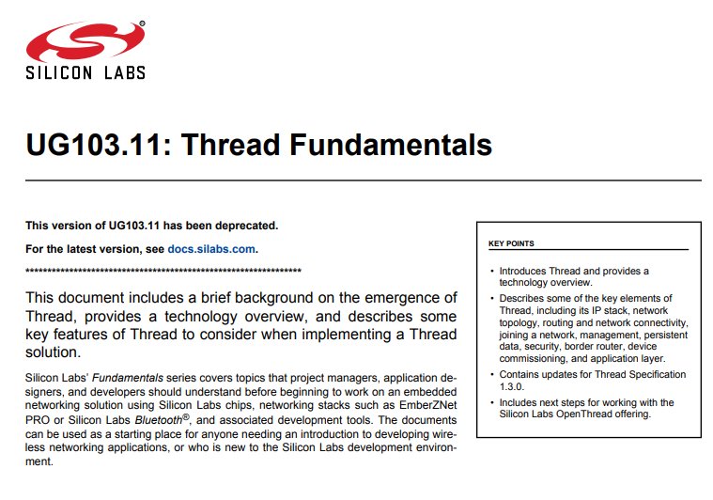
Plan
Gather Information

Slide 11
Plan
Metrics:
- Smart Home Automation?
- Building Automation?
- Real-Time?
- Provides SDK?
- Vendor Specific?
- Device Versatility?
- Cost?
- Security?
- Market Share?
High-Level Comparison
- Decision Matrix
***metrics are subject to change***

Slide 12
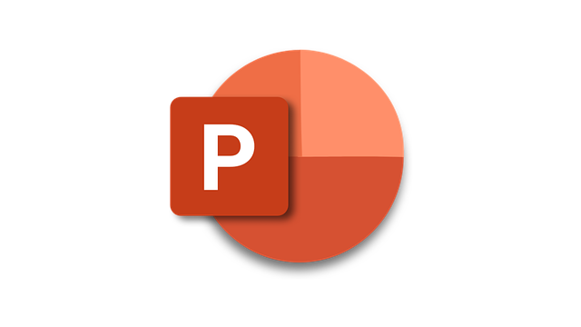
Plan
Present Results

Slide 13
References
Information
Today’s Homeowner
IEEE Explore
Silicon Labs
Consumer Affairs
Images
ZigBee Logo
Thread Logo
Z-Wave Logo
Weight Module
ESP32
Arduino
ESP8266
Raspberry Pi 4
LED Strip
Question

